Slide 1


Holy Spirt Led Fathers Should Demonstrate
JOY When
Laying Down
Their Life for
Christ’s Church
I John 3:16

Slide 2
I John 3:16 (NAS)
We know love by this, that He laid down His life for us; and we ought to lay down our lives for the brothers and sisters.

Slide 3
I John 3:11-18 (NAS)
¹¹ For this is the message which you have heard from the beginning, that we are to love one another; ¹² not as Cain, who was of the evil one and murdered his brother. And for what reason did he murder him?

Slide 4
I John 3:11-18 (NAS)
Because his own deeds were evil, but his brother's were righteous. ¹³ Do not be surprised, brothers and sisters, if the world hates you. ¹⁴ We know that we have passed out of death into life, because we love the brothers and sisters.

Slide 5
I John 3:11-18 (NAS)
The one who does not love remains in death. ¹⁵ Everyone who hates his brother or sister is a murderer, and you know that no murderer has eternal life remaining in him. ¹⁶ We know love by this, that He laid down His life for us;

Slide 6
I John 3:11-18 (NAS)
and we ought to lay down our lives for the brothers and sisters. ¹⁷ But whoever has worldly goods and sees his brother or sister in need, and closes his heart against him, how does the love of God remain in him?

Slide 7
I John 3:11-18 (NAS)
¹⁸ Little children, let's not love with word or with tongue, but in deed and truth.

Slide 8
Holy Spirit Led Fathers
Jesus Laid Down HIS Life for HIS Church
Jesus Endured the Pain and Suffering on the Cross for the JOY set before HIM
Holy Spirit Led Fathers Must Put CHRIST’s Will Before Self Will

Slide 9
Point #1: Jesus Laid Down HIS Life for HIS Church
Ephesians 5:25 (NAS) Husbands, love your wives, just as Christ also loved the church and gave Himself up for her,

Slide 10
Fathers are to emulate Christ’s love for the church, which is characterized by self-sacrifice, and devotion.
Christ gave himself for the church, demonstrating his love through action and commitment.

Slide 11
This example highlights that love for the Church is not just an emotion, but a choice to serve and sacrifice self if needed.

Slide 12
Point #2: Jesus Endured the Pain and Suffering on the Cross for the JOY set before HIM
Hebrews 12:2 (NAS)
looking only at Jesus, the originator and perfecter of the faith,

Slide 13
Hebrews 12:2 (NAS)
who for the joy set before Him endured the cross, despising the shame, and has sat down at the right hand of the throne of God.

Slide 14
In the Bible, joy is a state of deep inner happiness and contentment, often linked to spiritual realities and God's presence rather than external circumstances.

Slide 15
It's a fruit of the Spirit, meaning it's a result of living in alignment with God's will. Biblical joy is enduring and can be found even in difficult times, as it's rooted in faith and trust in God.

Slide 16
Biblical joy is described as an internal state of being, not just a fleeting emotion. It's something that lasts and is present even when external circumstances are challenging.

Slide 17
Connected to God and the Holy Spirit:
Joy is often seen as a gift from God, a result of being filled with the Holy Spirit.

Slide 18
Independent of Circumstances:
Biblical joy is not dependent on worldly happiness or achievements. It can be found even in suffering and hardship.

Slide 19
Point #3: Holy Spirit Led Fathers Must Put CHRIST’s Will Before Self Will
Matthew 22:37 (NAS)
And He said to him,

Slide 20
Matthew 22:37 (NAS)
"'YOU SHALL LOVE THE LORD YOUR GOD WITH ALL YOUR HEART, AND WITH ALL YOUR SOUL, AND WITH ALL YOUR MIND.'

Slide 21
Loving the Lord thy God with all thy heart, with all thy soul, and with all thy mind, is the central tenet of the Christian life. It emphasizes a complete and devoted love of GOD.

Slide 22
It encompasses one’s entire being. This love is not just an emotion but a commitment that involves one's thoughts, feelings and actions.

Slide 23
Matthew 6:33-34 (NAS)
³³ "But seek first His kingdom and His righteousness, and all these things will be provided to you. ³⁴ "So do not worry about tomorrow; for tomorrow will worry about itself. Each day has enough trouble of its own.

Slide 24
Revelation 2:10 (NAS)
'Do not fear what you are about to suffer. Behold, the devil is about to throw some of you into prison, so that you will be tested, and you will have tribulation for ten days. Be faithful until death, and I will give you the crown of life.

Slide 25
Proverbs 3:5 (NAS)
Trust in the LORD with all your heart And do not lean on your own understanding.

Slide 26

…that Christ died for our sins according to the scriptures;
And that he was buried, and that he rose again the third day according to the scriptures:

Slide 27
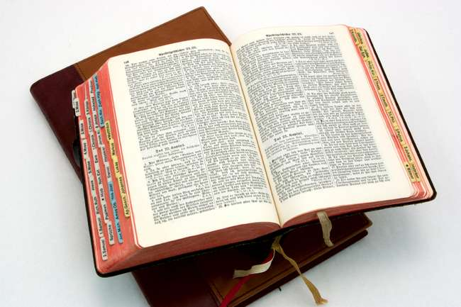
Hear: Romans 10:17
So then faith cometh by hearing, and hearing by the word of God.

Slide 28
Believe: Hebrews 11:6
But without faith it is impossible to please him: for he that cometh to God must believe that he is, and that he is a rewarder of them that diligently seek him.

Slide 29
Repent: Luke 13:3
I tell you, Nay: but, except ye repent, ye shall all likewise perish.

Slide 30
Confess: Matthew 10:32-33
32 Whosoever therefore shall confess me before men, him will I confess also before my Father which is in heaven.
33 But whosoever shall deny me before men, him will I also deny before my Father which is in heaven.

Slide 31
Baptize: Acts 22:16
And now why tarriest thou? arise, and be baptized, and wash away thy sins, calling on the name of the Lord.

